Slide 1
TEACHER CUE
CFU
HINT
Scaffolding for students
MAKE THE CONNECTION
Allow students to make the connection

Slide 2
Vector and Scalar quantities
Distance and displacement
Calculating speed and velocity
Distance time graphs
Speed time graph
Calculating acceleration
Balanced and unbalanced forces

Slide 3
I will be able to identify balanced and unbalanced forces
TRACK WITH ME
READ WITH ME
I can identify a balanced force and an unbalanced force
I will be able to calculate the weight of an object

Slide 4
I will be able to identify balanced and unbalanced forces
MAKE THE CONNECTION
What is a force?
A force can be a push or pull on an object.

Slide 5
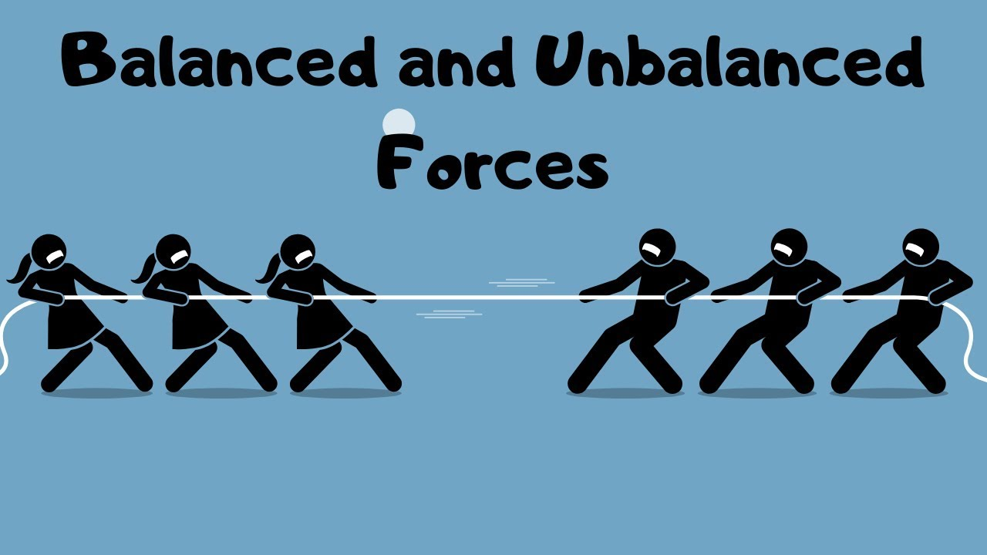
I will be able to identify balanced and unbalanced forces
There are two types of forces,
Balanced and
Unbalanced

Slide 6
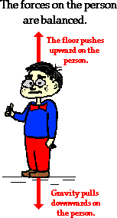
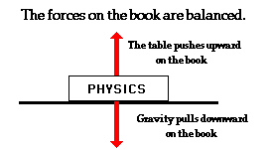
I will be able to identify balanced and unbalanced forces
Balanced Forces
When forces are equal then an object will not move (continue to do nothing)

Slide 7
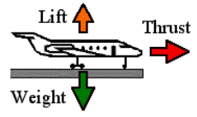
I will be able to identify balanced and unbalanced forces
Unbalanced forces
When an object moves an unbalanced force is acting on it.
When a plane takes off it is unbalanced which allows it to fly

Slide 8
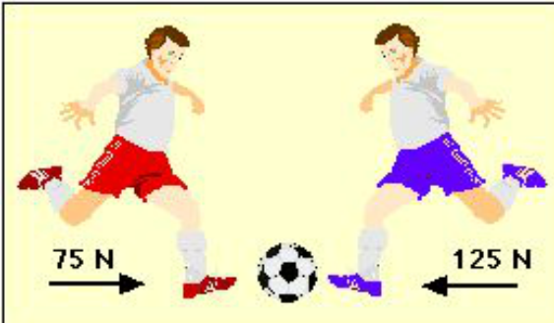
I will be able to identify balanced and unbalanced forces
Forces are measured in Newtons (N)
When we draw a force diagram we use arrows called vectors
Which direction does the
Ball go?

Slide 9
I will be able to identify balanced and unbalanced forces
There are different types of forces
Weight = gravity
Thrust = going forward from an engine usually
Upward push= This is the opposite force opposing gravity stopping the bus moving downwards
Reaction force = opposes main force (air resistance or friction)

Slide 10
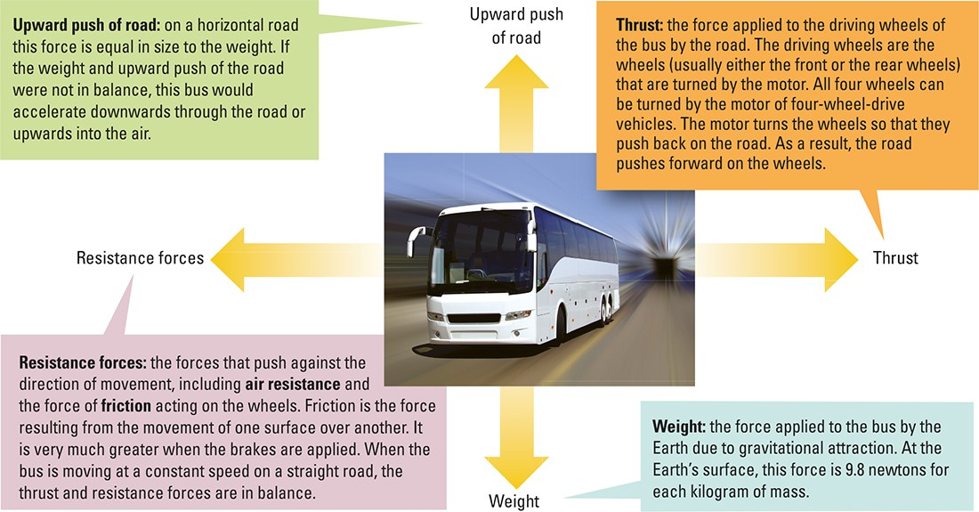

Slide 11
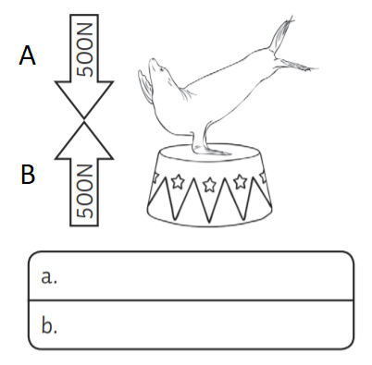
I will be able to identify balanced and unbalanced forces
Is this balanced or unbalanced?
What type of force is down (A)
What type of force opposes this? (B)

Slide 12
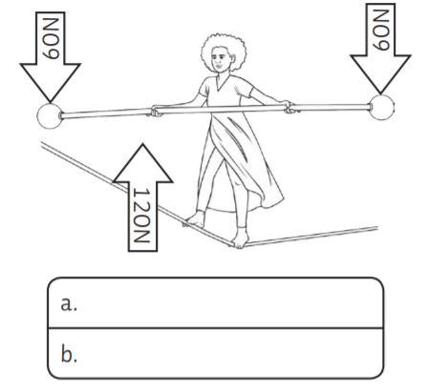
I will be able to identify balanced and unbalanced forces
Is this balanced or unbalanced?
What type of force is down (A)
What type of force opposes this? (B)

Slide 13
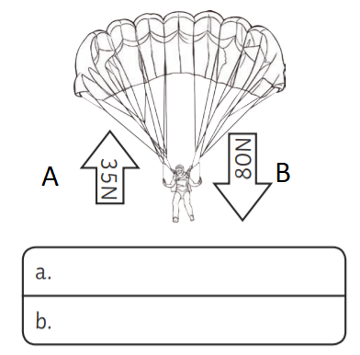
I will be able to identify balanced and unbalanced forces
Is this balanced or unbalanced?
What type of force is A?
What type of force is B?

Slide 14
I will be able to identify balanced and unbalanced forces
Calculating Weight
The force of gravitational attraction is called weight. The weight of an object can be calculated by:
Weight = mg
Weight = mass x gravity
Gravity = 9.8 N/kg

Slide 15
I will be able to identify balanced and unbalanced forces
Example
What is the weight of an object that’s mass is 1kg.
Weight = mg
Weight = 1kg x 9.8 N/kg
Weight = 9.8N

Slide 16
I will be able to identify balanced and unbalanced forces
Calculate
The weight of a 2000 kg bus.

Slide 17
I will be able to identify balanced and unbalanced forces
Calculate
What is your weight if you have a 55kg mass.

Slide 18
I will be able to identify balanced and unbalanced forces
TEACHER CUE
CFU
Activity:
Go to connect ➔ Library ➔ Physics ➔ Forces
Complete the activities and try to create balanced and unbalanced forces.

Slide 19
I will be able to identify balanced and unbalanced forces
TRACK WITH ME
READ WITH ME
I can identify a balanced force and an unbalanced force
I will be able to calculate the weight of an object

